Slide 1

INTRODUCTION TO OPTIMIZATION
LINEAR PROGRAMMING

Slide 2
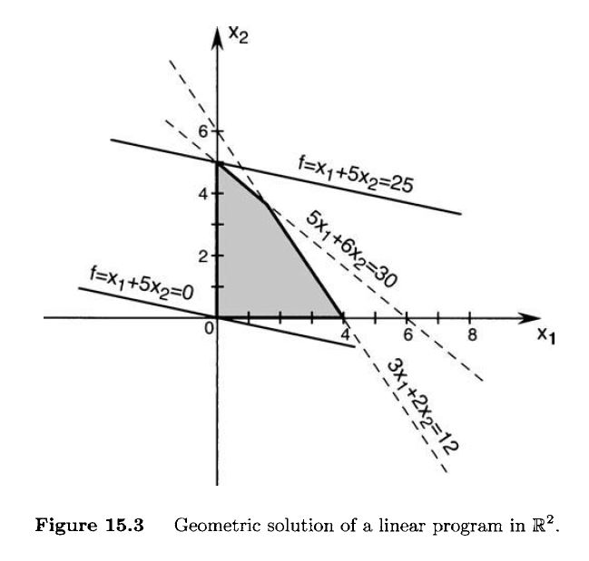


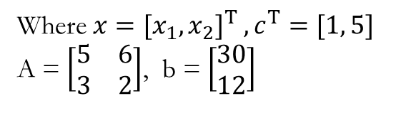

* Two-Dimensional Linear Programs
• Linear problems in $ℝ^{2}$
$$maximize { c}^{T}x$$
$$subject to Ax≤b$$
$x≥0$
Where $x={[x_{1}, x_{2}]}^{T} ,c^{T}=[1, 5]$
A = $\left[\begin{matrix}5 & 6 \\ 3 & 2\end{matrix}\right]$, b = $\left[\begin{aligned}30 \\ 12\end{aligned}\right]$
Set of equations → {$c^{T}x=x_{1}+5x_{2}= f , f∈ℝ\}$
Thus, We can choose several values for $x_{1}, and x_{2}$ and we can make $f$ while still satisfying the constrains on $x_{1}, and x_{2}$. (With Geometrically solution)

Slide 3


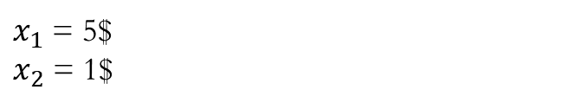
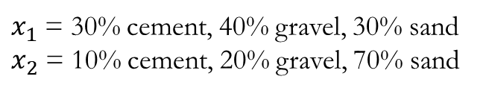


* Two-Dimensional Linear Programs
• Example
Two different types of concrete $x_{1}$ and $x_{2}$
$x_{1}$ and $x_{2}$ costs
$x_{1}$ = 30% cement, 40% gravel, 30% sand
$x_{2}$ = 10% cement, 20% gravel, 70% sand
$x_{1}$ = 5$
$x_{2}$ = 1$
Problem : Minimize Cost, but you get concrete mixture that has at least a total of 5 pounds of cement, 3pounds of gravel, 4 pounds of sand.
The problem can be represented as
$$minimize { c}^{T}x$$
$$subject to Ax≥b$$
$x≥0$
$$c^{T}=[5, 1]$$
A = $\left[\begin{aligned}\begin{matrix}0.3 & 0.1 \\ 0.4 & 0.2\end{matrix} \\ 0.3 0.7\end{aligned}\right]$, b = $\left[\begin{aligned}5 \\ 3 \\ 4\end{aligned}\right]$

Slide 4
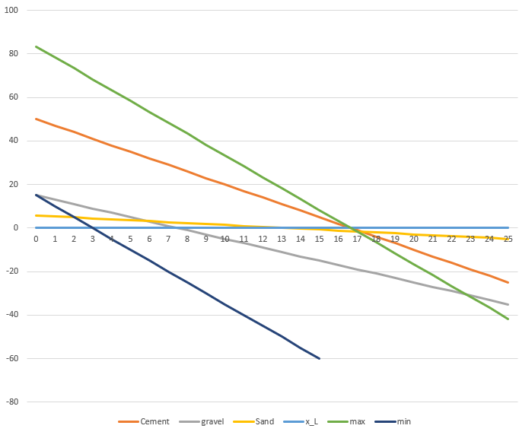


* Two-Dimensional Linear Programs
• Example
$$minimize { c}^{T}x$$
$$subject to Ax≥b$$
$x≥0$
$$c^{T}=[5, 1]$$
A = $\left[\begin{aligned}\begin{matrix}0.3 & 0.1 \\ 0.4 & 0.2\end{matrix} \\ 0.3 0.7\end{aligned}\right]$, b = $\left[\begin{aligned}5 \\ 3 \\ 4\end{aligned}\right]$
With Geometrically solution
f = 5x1 + x2 = 15

Slide 5
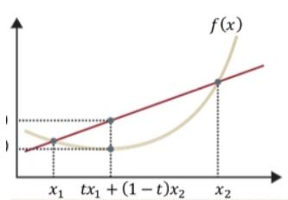

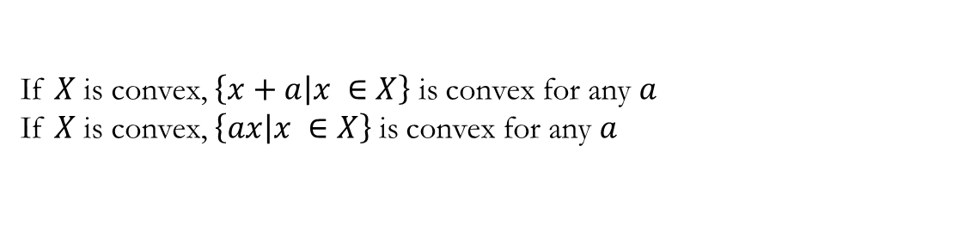
* Two-Dimensional Linear Programs
• Convex Polyhedra and Linear Programming
The goal of linear programming is to minimize(or maximize) a linear object function.
$c^{T}x$ = $c_{1}x_{1}$ + $c_{2}x_{2}$ + $c_{3}x_{3}$ + … + $c_{n}x_{n}$
The set of points satisfying these constraints can be represented as the intersection of finite number of closed half-spaces. Thus the constraints define a Convex Polytope
! Convex(볼록)
집합에서 임의의 점 두 점 사이 임의의 점 모두가 집합안에 포함되어 있는 집합
If $X$ is convex, $\left\{\left.x+a\right|x ∈X\right\}$ is convex for any $a$
If $X$ is convex, $\left\{\left.ax\right|x ∈X\right\}$ is convex for any $a$
! Convex function(볼록 함수)
$f\left(x\right)$is convex if $f\left({tx}_{1}+(1 −t)x_{2}\right) ≤tf\left(x_{1}\right)+\left(1 −t\right)f\left(x_{2}\right)$ for any $x_{1}$, $x_{2}$ and $t ∈[0, 1]$

Slide 6
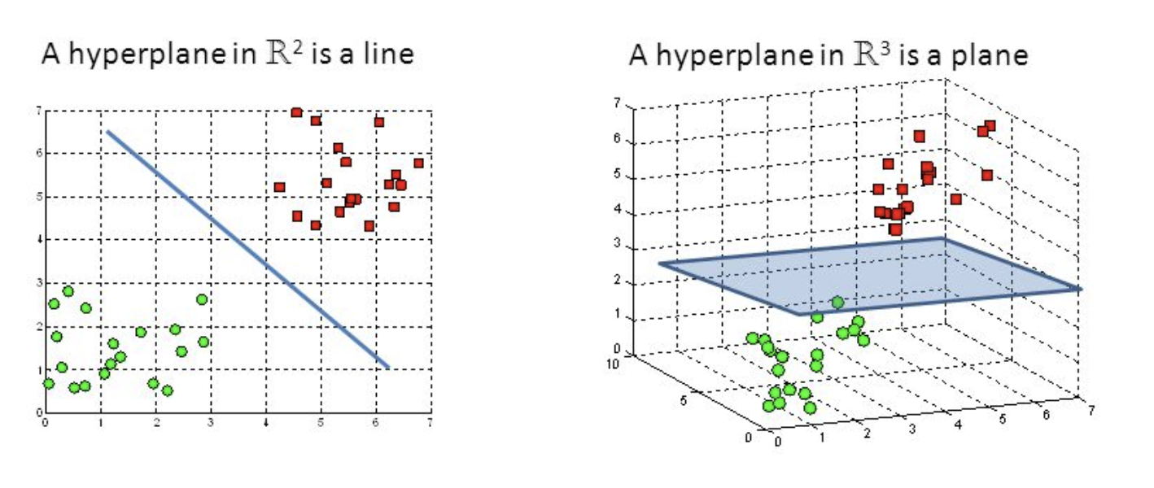

* Two-Dimensional Linear Programs
• Convex Polyhedra and Linear Programming
The equations of constraints define a polyhedron(다면체) M in $ℝ^{n}$.
Let H be a hyperplane of support of this polyhedron.
Hyperplane
* $c^{T}x$ = k 를 만족하는 $x∈ℝ^{n}의$ 집합 H

Slide 7
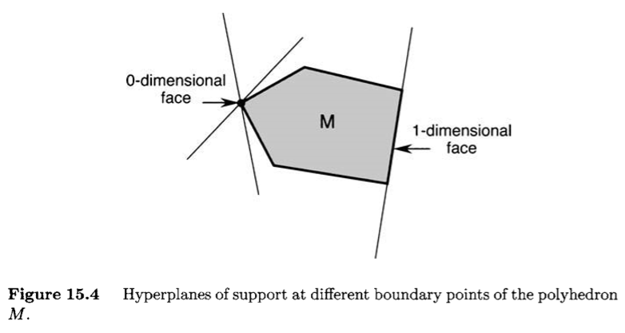
* Two-Dimensional Linear Programs
• Convex Polyhedra and Linear Programming

Slide 8



* Two-Dimensional Linear Programs
• Convex Polyhedra and Linear Programming
The goal of our linear programming problem is to maximize a linear objective function f(x) on the convex polyhedron M.
1. Let $H$ be the hyperplane defined by the equation
$c^{T}x=0$
2. A hyperplane of support $\tilde{H}$ to the polyhedron $M$, which is parallel to $H$ and positioned such that the vector c points in the direction of the half-space that does not contain $M$
$c^{T}x=β$
3. Denote by $\tilde{M}$ the convex polyhedron that is the intersection of the hyperplane of support $\tilde{H}$ with the polyhedron $M$.
4. To this end, let $y$ and $z$ be two arbitrary points in $\tilde{M}$. This implies that both $y$ and $z$ belong to $H$.
$$f\left(y\right)= c^{T}y= β=c^{T}z=f(z)$$

Slide 9
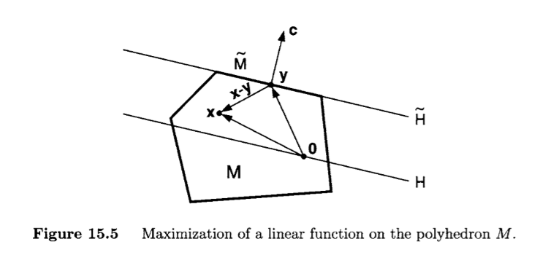
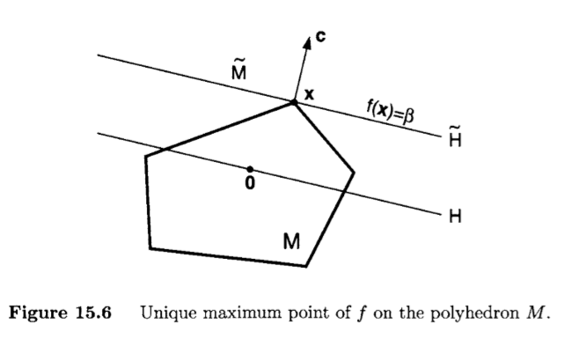



* Two-Dimensional Linear Programs
• Convex Polyhedra and Linear Programming
$y$ be a point of $\tilde{M}$, and let $x$ be a point of $M$
$$c^{T}x< β=c^{T}y$$
$$f\left(x\right)<f(y)$$

Slide 10



* Two-Dimensional Linear Programs
• Standard Form Linear Programs
We refer to a linear program of the form
$$minimize { c}^{T}x$$
$$subject to Ax=b$$
$x≥0$
Here $A$ is an $m×n$matrix composed of real entries, $m<n$, rank $A$ = $m$
$$minimize { c}^{T}x$$
$$subject to Ax=b$$
$x≥0$
$$minimize { c}^{T}x$$
$$subject to Ax≥b$$
$x≥0$
Standard Form
Canonical Form

Slide 11

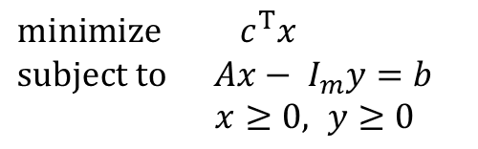

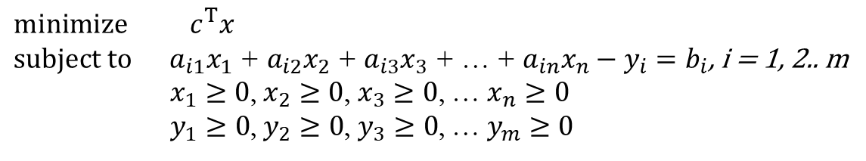

* Two-Dimensional Linear Programs
• Standard Form Linear Programs
* Canonical Form
$$minimize { c}^{T}x$$
$$subject to Ax≥b$$
$x≥0$
* Surplus variables $y_{i}$
$$minimize { c}^{T}x$$
$$subject to Ax=b$$
$x≥0$
$$minimize { c}^{T}x$$
$subject to a_{i1}x_{1}\text{ + }a_{i2}x_{2}\text{ + }a_{i3}x_{3}\text{ + … + }a_{in}x_{n}−y_{i}=b_{i}$, i = 1, 2.. m
$x_{1}≥0$, $x_{2}≥0$, $x_{3}≥0$, … $x_{n}≥0$
$y_{1}≥0$, $y_{2}≥0$, $y_{3}≥0$, … $y_{m}≥0$
$$minimize { c}^{T}x$$
$$subject to Ax− I_{m}y=b$$
$x≥0, y≥0$

Slide 12

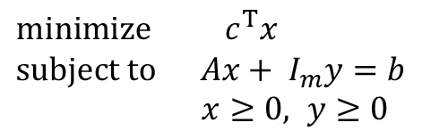

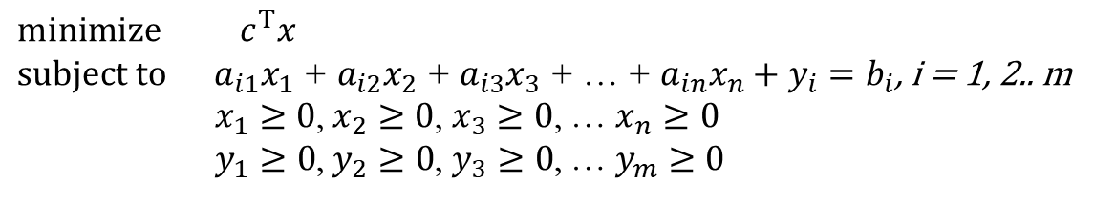

* Two-Dimensional Linear Programs
• Standard Form Linear Programs
* Canonical Form
$$minimize { c}^{T}x$$
$$subject to Ax≤b$$
$x≥0$
* Slack variables $y_{i}$
$$minimize { c}^{T}x$$
$$subject to Ax=b$$
$x≥0$
$$minimize { c}^{T}x$$
$subject to a_{i1}x_{1}\text{ + }a_{i2}x_{2}\text{ + }a_{i3}x_{3}\text{ + … + }a_{in}x_{n}+y_{i}=b_{i}$, i = 1, 2.. m
$x_{1}≥0$, $x_{2}≥0$, $x_{3}≥0$, … $x_{n}≥0$
$y_{1}≥0$, $y_{2}≥0$, $y_{3}≥0$, … $y_{m}≥0$
$$minimize { c}^{T}x$$
$$subject to Ax+ I_{m}y=b$$
$x≥0, y≥0$

Slide 13

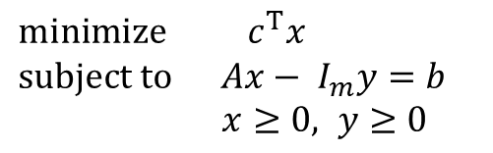
* Two-Dimensional Linear Programs
• Standard Form Linear Programs
$$minimize { c}^{T}x$$
$$subject to Ax− I_{m}y=b$$
$x≥0, y≥0$
$$minimize { c}^{T}x$$
$$subject to Ax≥b$$
$x≥0$
Standard Form
Canonical Form
This problem refers to an intersection of half-spaces and hyperplanes in the (n + m)-dimensional space.
This problem refers to the intersection of
half-spaces in the n-dimensional space
Both forms are equivalent

Slide 14
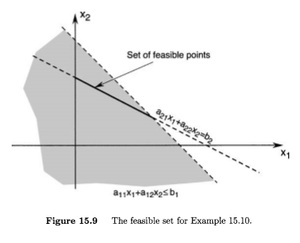


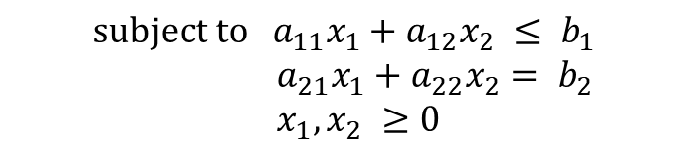
* Two-Dimensional Linear Programs
• Standard Form Linear Programs
* Example
Maximize $f\left(x_{1},x_{2}\right)=c_{1}x_{1}+c_{2}x_{2}$
$$subject to a_{11}x_{1}+a_{12}x_{2} ≤ b_{1}$$
$a_{21}x_{1}+a_{22}x_{2}= b_{2}$
$x_{1}, x_{2} ≥0$
$a_{ij} >0$ and $b_{1},b_{2} ≥0$

Slide 15


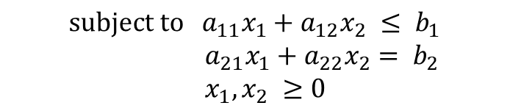
* Two-Dimensional Linear Programs
• Standard Form Linear Programs
* Example
Maximize $f\left(x_{1},x_{2}\right)=c_{1}x_{1}+c_{2}x_{2}$
$$subject to a_{11}x_{1}+a_{12}x_{2} ≤ b_{1}$$
$a_{21}x_{1}+a_{22}x_{2}= b_{2}$
$x_{1}, x_{2} ≥0$
Convert the constraints into standard form:
$$a_{11}x_{1}+a_{12}x_{2}+x_{3}= b_{1}$$
$a_{21}x_{1}+a_{22}x_{2}= b_{2}$
$x_{i}≥0$, i = 1, 2, 3
Let $C_{2} ⊂ ℝ^{3}$ be the set of points satisfying the constraints.

Slide 16
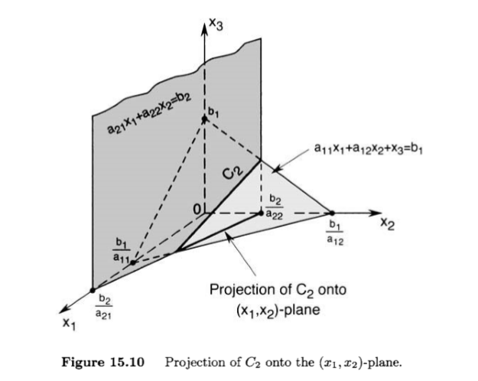
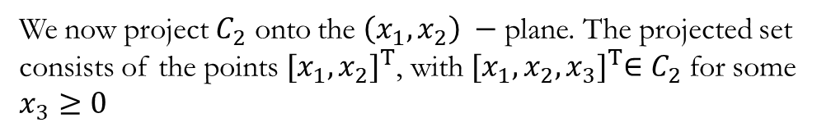
* Two-Dimensional Linear Programs
• Standard Form Linear Programs
* Example
Let $C_{2} ⊂ ℝ^{3}$ be the set of points satisfying the constraints.
We now project $C_{2}$ onto the $\left(x_{1},x_{2}\right) −$plane. The projected set consists of the points ${[x_{1},x_{2}]}^{T}$, with ${[x_{1},x_{2},x_{3}]}^{T}∈C_{2}$ for some $x_{3}≥0$

